Slide 1
Railway Database
Presented to:
Mr. Jon Collins & Mr. Andrew Poss
March 5, 2019
Winona State University
Database CS485
Nick Schinke/Joe Denzer

Slide 2
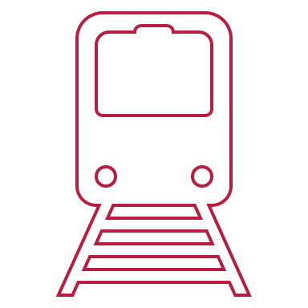
discussion with clients on system capabilities
Trains with an ID and a name
Stations, schedules, routes, departure and arrival times
Sequenced numbered stations and schedules
Passenger booking consisting of seat, from station, to station, coach class, route, passenger name

Slide 3
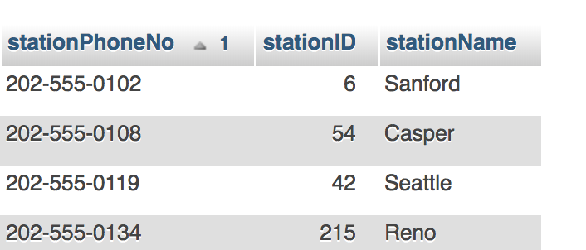
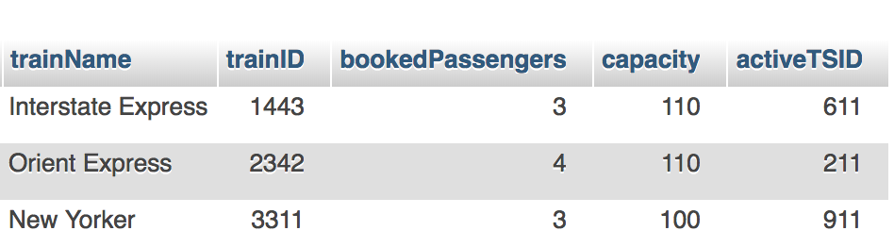
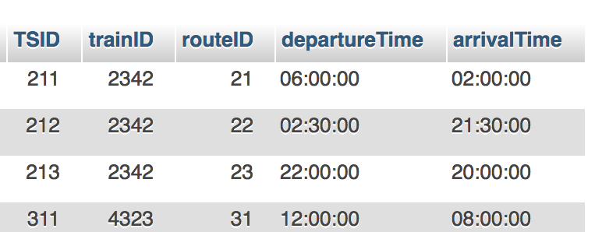
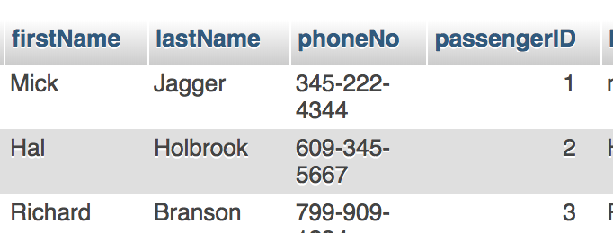
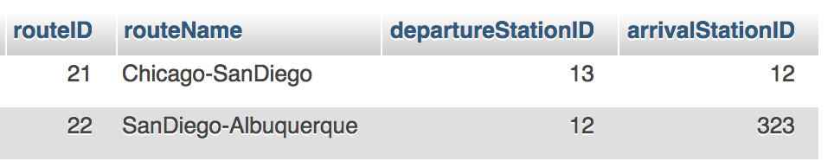
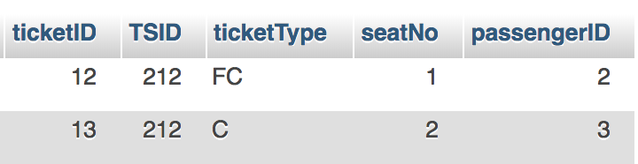
Stations
Trains with an ID and a name
Train schedules.
Passenger booking
Train routes
Ticketing

Slide 4
Use Cases

Slide 5
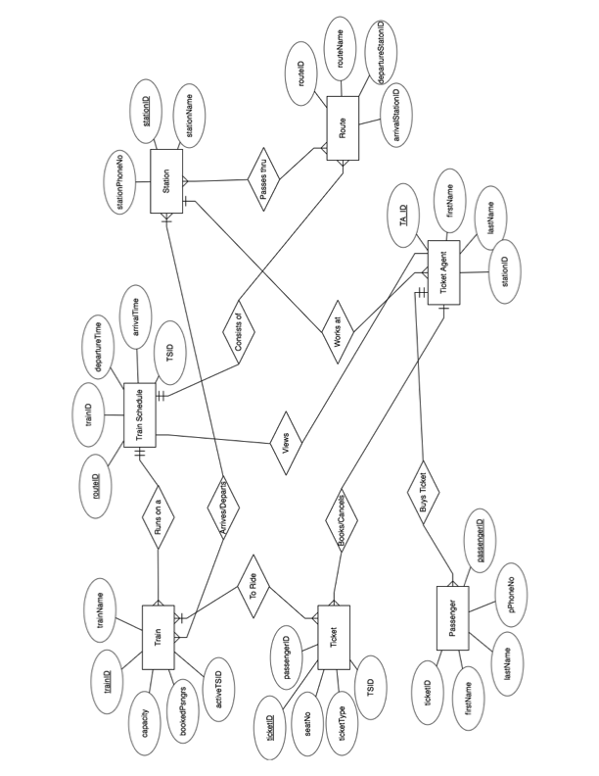
ERD

Slide 6
Display Queries
Queries to display results:
displayRoutes(); // Displays all routes
displayTrains(); // Displays all trains
displayPassengers(); // Displays all passengers
displayTicket();// Joins Ticket, Route and Train Schedule
viewStations(); //Displays all the stations
routeSchedule(); // Joins Route and Schedule

Slide 7
Search Queries
getSeatNo(passengerID); //get seat no by psngr ID
getStationID(stationName); //get stationID by its name
getStationName(stationID); //get station name by its ID
getArrivalStation(int departureID); //get arrival ID
searchPassenger(fName, lName); //Search for passenger by name
stationSearch(stationName); // Search for a station by name
getTSID(arriveID, departID)//get train schedule ID
getTrainCapacity(trainID);//get train’s capacity

Slide 8
Update and helper Queries
issueTicket(passenger, seat, and trip info); // Add a ticket to system
insertPassenger(passenger info); //Add a passenger to the system
getMaxPassengerID(); // get the last issued passenger ID

Slide 9
Route Schedule from Casper, WY to Chicago, IL
Chicago
Casper:
Eugene: 43
Seattle: 44
Vancouver: 45
Spokane: 42
Chicago: 46

Slide 10
Route Schedule from Casper, WY to Spokane, WA
Casper:
Spokane: 42

Slide 11
Steps to issue ticket(s) for a trip
Determine if current and destination cities are on routes:
String sql = "SELECT stationName FROM Station WHERE Station.stationName = ?";
Gather ticket type and information about passenger:
Get current station ID, destination station ID and arrival ID (the next station on route when leaving from your current station) *Trains go one way ONLY
do {
if (destStationID == arriveID) { //if the next stop is your intended destination, issue one ticket

Slide 12
Steps to issue ticket(s) for a trip
Else, passenger chooses a seat number and a ticket is issued for this leg of the trip:
dao.issueTicket(ticketID, TSID, ticketType, seatChoice, passengerID);
Reset the variables for the next leg of trip
// arrival station of first leg becomes departure station of 2nd leg
currentStationID = arriveID;
// get new arrival station given the new departure station
arriveID = dao.getArrivalStationID(currentStationID); //Repeat until final leg is found

Slide 13
Passenger creates an account and is inserted into database
Passenger creates an account:
public static byte[] hash(char[] password, byte[] salt) {
PBEKeySpec spec = new PBEKeySpec(password, salt, 10000, 256);
Arrays.fill(password, Character.MIN_VALUE);
The passenger is registered and inserted into the database with login information:
dao.insertPassenger(firstN, lastN, ticketID, phoneNo, passengerID, login, salt, getHash(password, salt));

Slide 14
Tickets are issued
String sql ="SELECT Ticket.ticketID, Ticket.ticketType, "
+ "Ticket.seatNo, Route.routeName, "
+ "TrainSchedule.departureTime, TrainSchedule.arrivalTime "
+ "FROM TrainSchedule "
+ "JOIN Ticket ON TrainSchedule.TSID = Ticket.TSID "
+ "JOIN Route ON TrainSchedule.routeID = Route.routeID "
+ "WHERE Ticket.passengerID = ? ";

Slide 15
Conclusion
Demands met
Bonus capabilities
Trains with an ID and a name
Stations, schedules, routes, departure and arrival times
Sequenced numbered stations and schedules
Passenger booking consisting of seat, from station, to station, coach class, route, passenger name
Passenger user options:
View routes, trains, schedules, times, look up seat number
Ticket Agent options:
List all passengers (in the event of an emergency)

Slide 16

Thank You for your business
Questions or Concerns?

